Slide 1
DBMS FINAL PROJECT
GYM
MANAGEMENT SYSTEM
Submitted by: Mehfooz Ali (04)

Slide 2


GYM
MANAGEMENT SYSTEM

Slide 3
ACKNOWLEDGMENT
It’s our esteemed pleasure to present the project report on
“GYM Management System”
We would like to express our special thanks of gratitude to our Professor who gave us the golden opportunity to do this wonderful project on the topic “GYM Management System” with MYSQL database, which also helped us in doing a lot of Research and we came to know about so many new things we are really thankful to him.

Slide 4
INTRODUCTION
This GYM Management System is developed for Local GYM, those are using a manual system to handle members, Update and Payment system processes reservation system is to keep record.
Using this system user can check their all records easily, they can add, add new record, maintain record, and can manage the Items. GYM Management module helps user to become aware about all information of system.
The main reason of developing this system is to computerize all the activity of the GYM System like entry of a New Member, Update Record, Assigning a new records, monthly fee payment.

Slide 5
PURPOSE OF SYSTEM
To improve the management of data in the system and enable the user to access all the facilities easily in a user friendly environment.
Functions to be provided:
This program will be user friendly and completely menu driven so that the users shall have no problem in using all options.

Slide 6
PROJECT SCOPE
Our project aims at Business process automation, i.e. we have tried to computerize various processes of GYM System. In the sector of GYM areas we have computerizes their department and stock maintenance.
Scope of any software depends upon the following things:
It satisfy the user requirement
Be easy to understand by the user and operator
Be easy to operate
Have a good user interface
Be expandable
Delivered on schedule within the budget.

Slide 7
AIMS & OBJECTIVE
Aims is to generate GYM System with all the charges and penalty. Manual system that is only makes the process more difficult and hard.
The aim of our project is to develop a system that is meant to partially computerize the work performed in the GYM Areas, Company like generating data and record.

Slide 8
MOTIVATION
Only admin can manage all the accounts including the members records.
This system also has the feature to add and delete record and students in case a customer wants to cut the connection or an students wants to leave the gym.

Slide 9
DESCRIPTION
This project is for GYM Management System, where you can add the records of gym. Furthermore; you can add Update, Delete, subsequently it will show the payments according to your members.
Advantages of this Project:
It can help in avoiding the problem of standing in a queue to make the payment.
This can save a lot of time.
All the details of the customers payment are easily made available through the use of this program without any difficulty.
This application is reliable enough for everyone

Slide 10
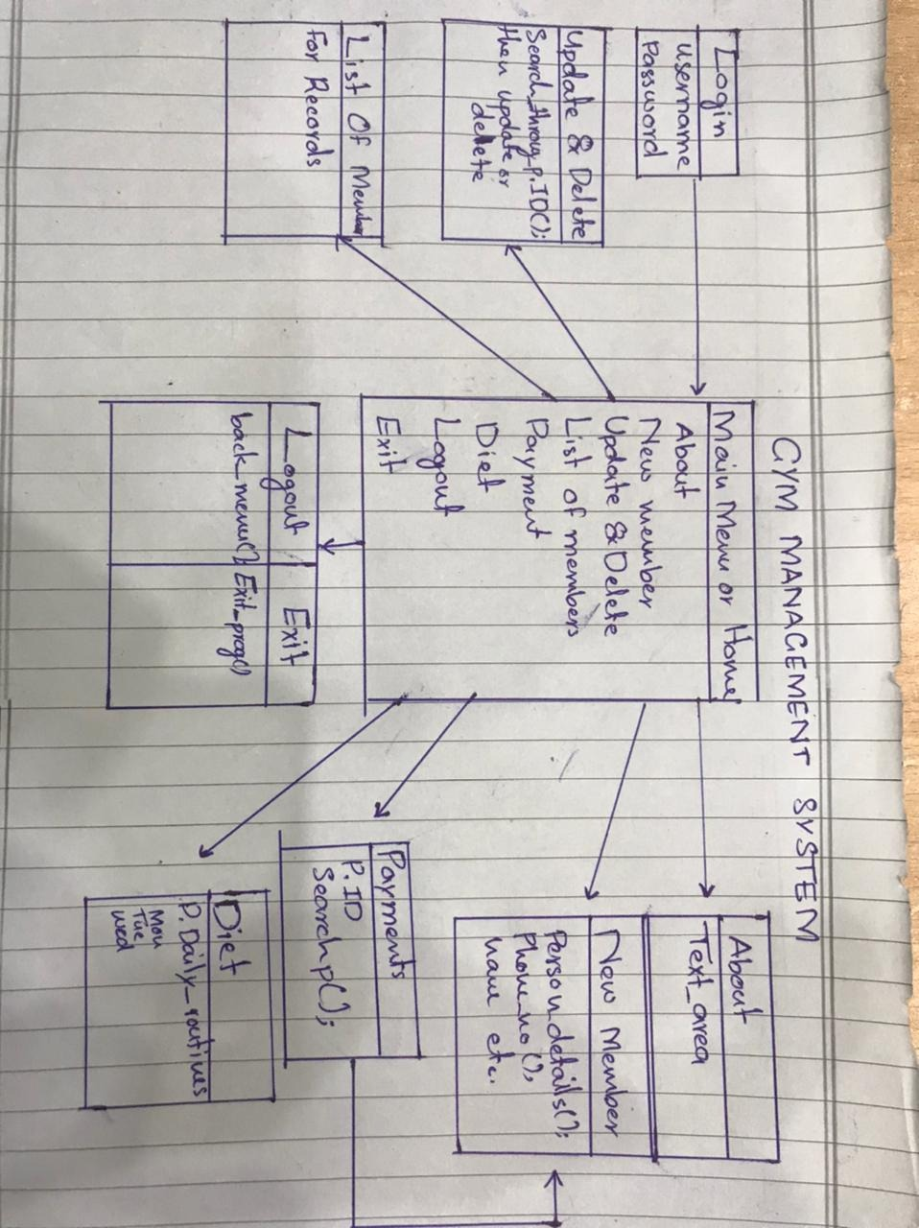
UML DIAGRAM

Slide 11
TASK INFO
NAME | TASKS
MEHFOOZ ALI | Coding + JFrame + User Interface + Testing
ABDUL WAHID | Coding + JFrame + User Interface + Testing
SYED WAJID HUSSAIN | Coding + Project Report + Testing
SYED WAJID HUSSAIN | Coding + Idea of Project + Testing
For making this program our respected Teacher helped us in this program to make it user friendly for user and easy to understand.

Slide 12
SNAPS

Slide 13
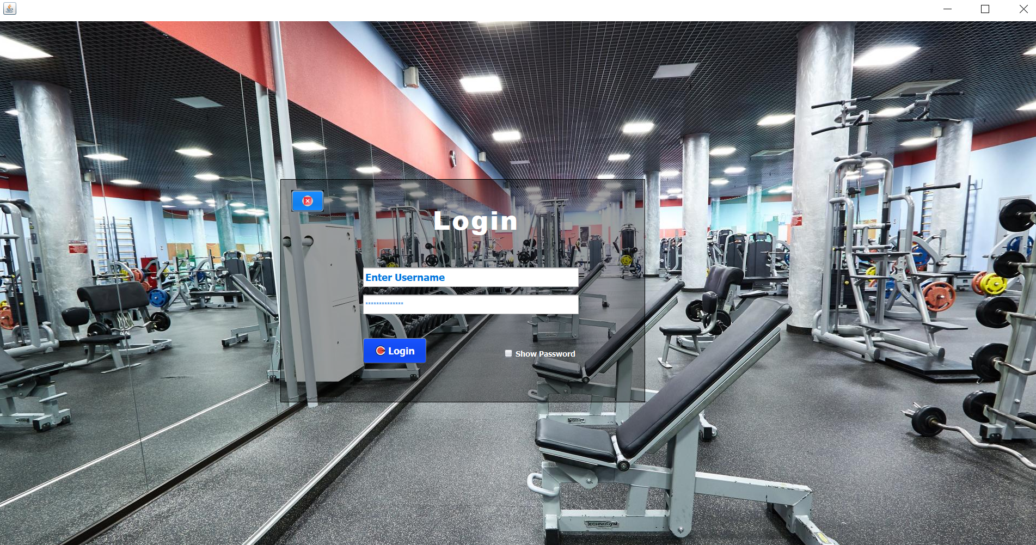

Slide 14
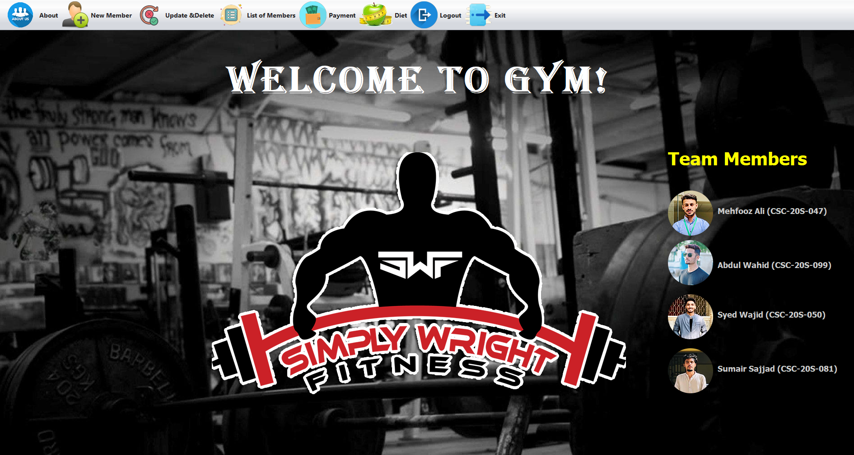

Slide 15
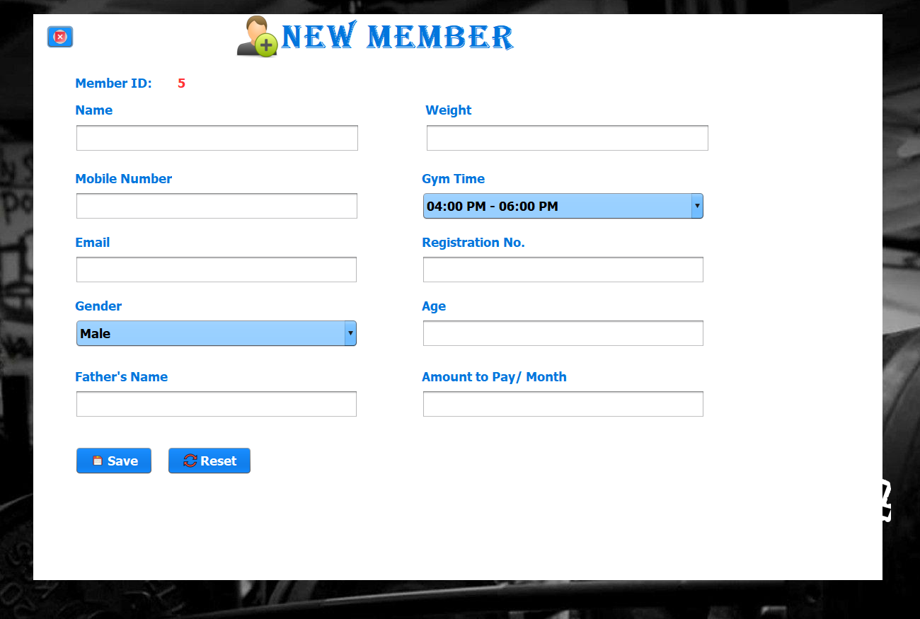

Slide 16
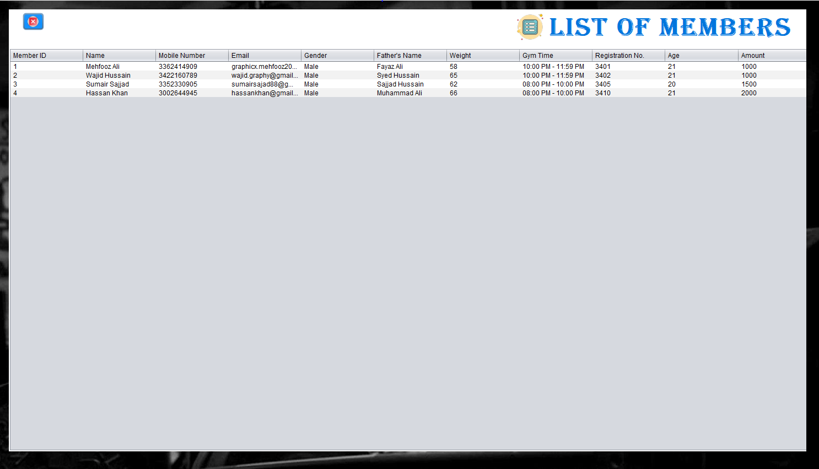

Slide 17
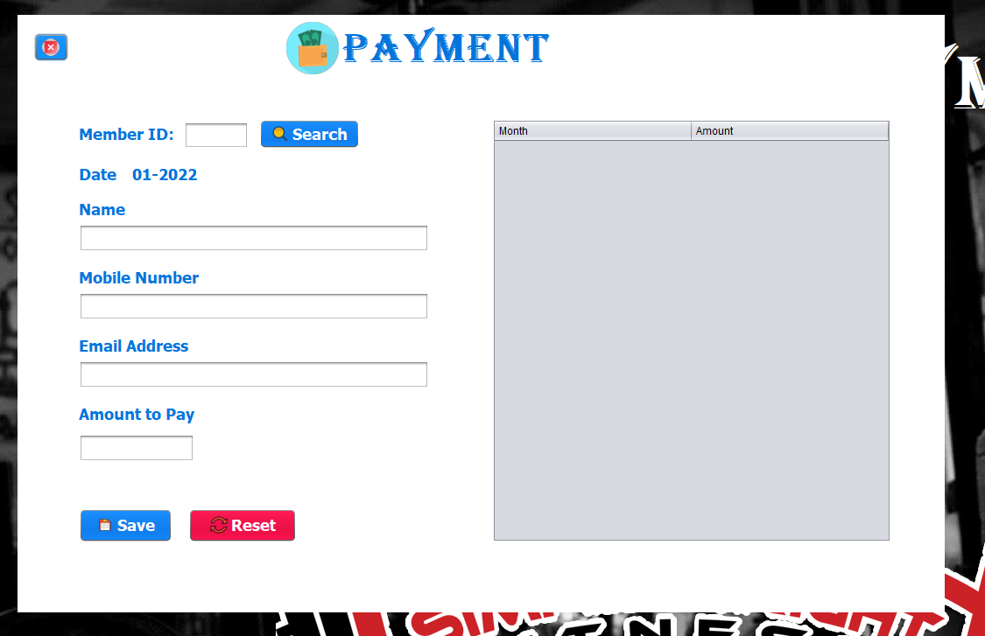

Slide 18
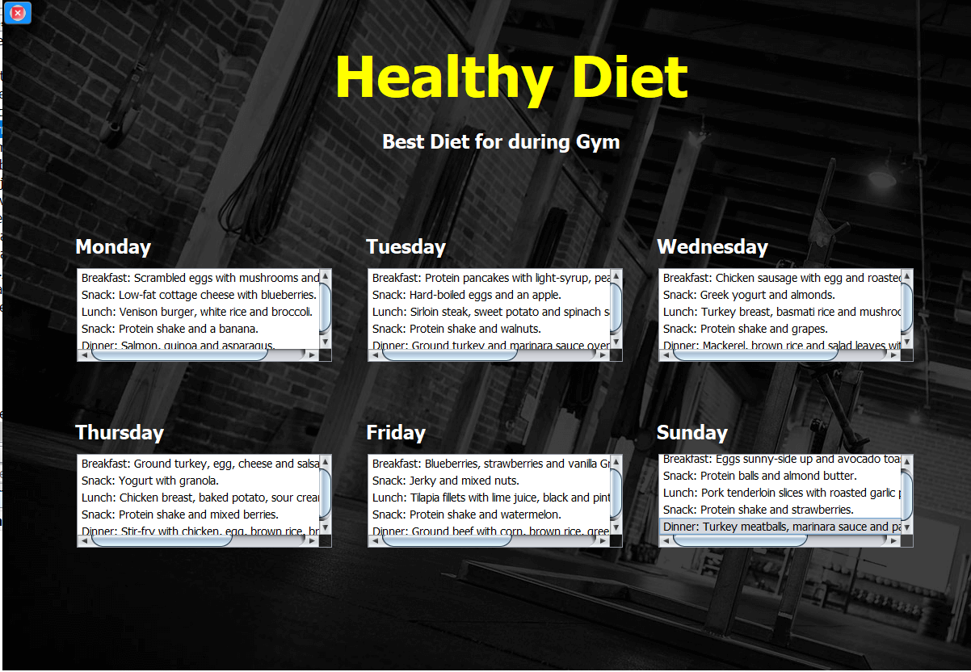

Slide 19
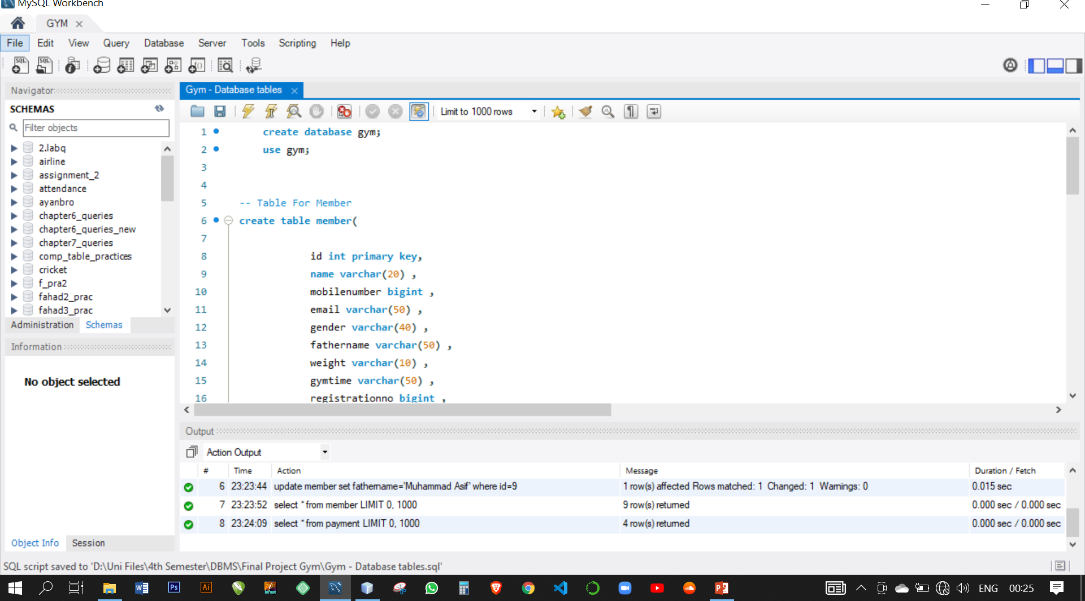
Queries

Slide 20
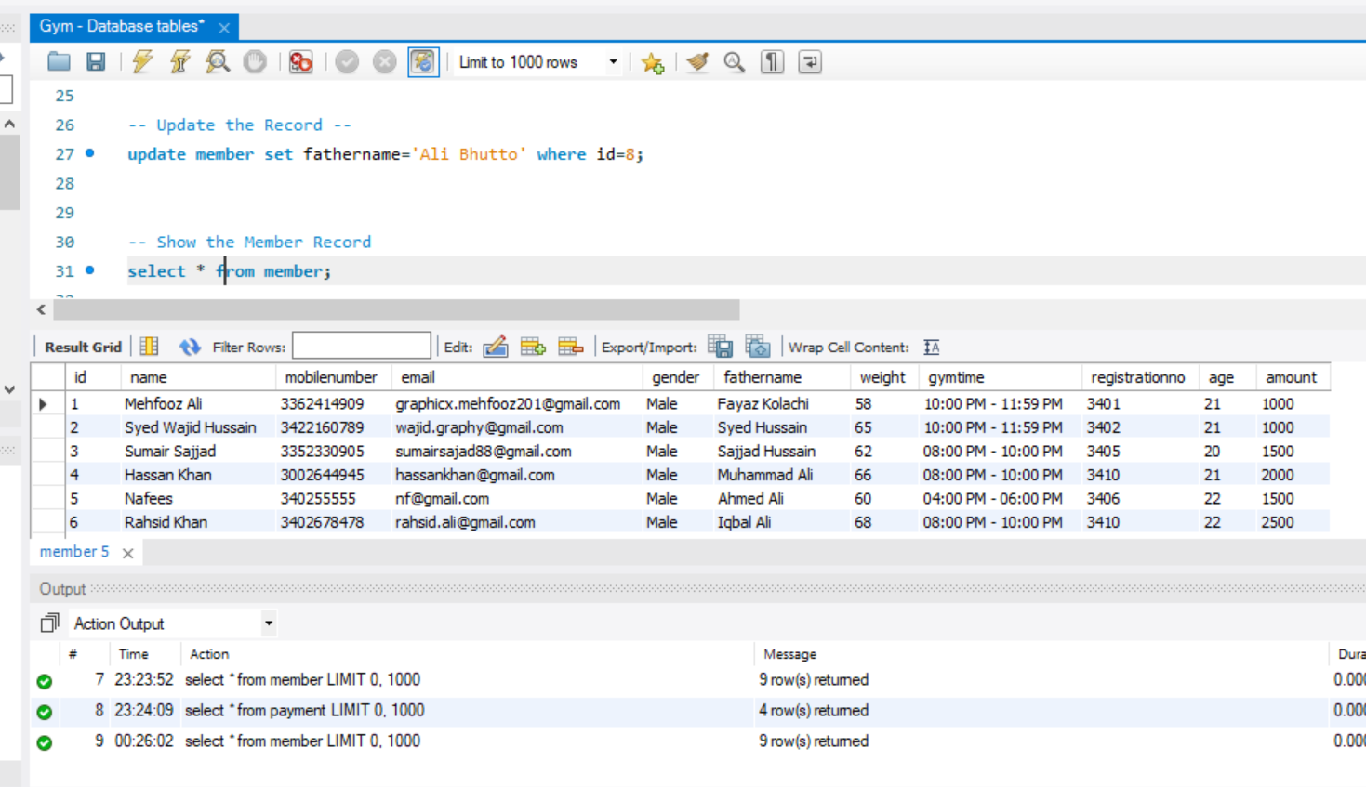
Queries

Slide 21
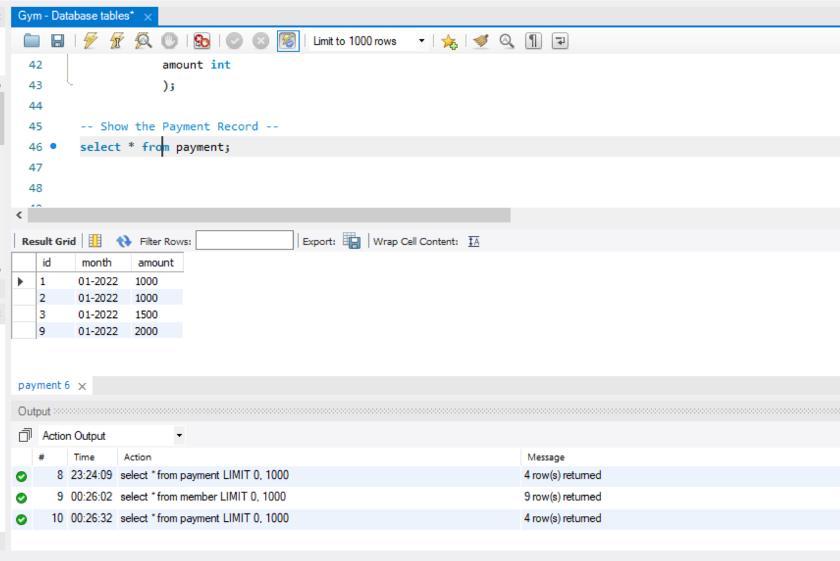
Queries

Slide 22
THANKS
For Supporting Us !!

Slide 23
If you have question
Don’t Ask ! okhe !

